Slide 1



Air Quality prediction
Arjun College Of Technology
Panthangi.Santhosh Kumar
Yanamala.Ganesh
Dumpa.Chaithanya
Thombarapu.Kumar

Slide 2
Problem Statement
Air quality significantly affects public health and the environment, especially in urban areas. Pollutants like PM2.5, PM10, nitrogen dioxide (NO2), carbon monoxide (CO), ozone (O3), and sulfur dioxide (SO2) contribute to serious health problems such as respiratory and heart diseases. Predicting air quality accurately is difficult due to the many factors involved, including pollution sources, weather conditions, and location.
Project Objective: The goal is to create a model that predicts air quality levels (e.g., PM2.5, NO2, O3) using environmental, weather, and human activity data. This will help in making informed decisions for public health, policy, and urban planning.
Key Objectives: Enable Real-Time Forecasting
Develop an Accurate Prediction Model:
Improve Urban Planning:
Source :
www.freepik.com/

Slide 3
Solution
Data Collection:
Gather historical data from sources like air quality stations, weather forecasts, traffic patterns, and pollution sources.
Data Preprocessing:
Clean the data by handling missing values and outliers.
Scale and normalize the data to ensure consistency.
Model Development:
Build a machine learning model (e.g., Linear Regression, Random Forest, or time-series models like ARIMA or LSTM) to predict future air quality.
Model Evaluation:
Measure the model’s accuracy using metrics like RMSE, MAE, and R-Squared.
Deployment:
Deploy the model to provide real-time air quality forecasts for specific locations.
Source :
www.freepik.com/

Slide 4
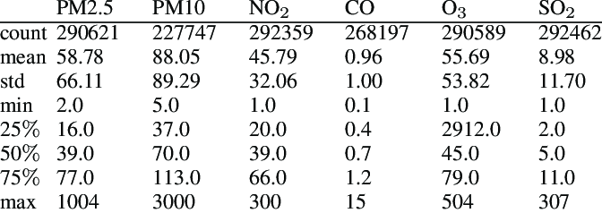
Dataset Overview
Date and Time: When the data was recorded.
Air Pollutants: Levels of harmful substances like PM2.5, PM10, NO2, CO, SO2, O3, VOC, and NH3.
Weather Data: Information like temperature, humidity, wind speed, and pressure that affects air quality.
Location: Where the data is collected (latitude, longitude).
Air Quality Index (AQI): A score showing how good or bad the air quality is.
Other Factors: Extra data like precipitation or solar radiation.
Source :
www.freepik.com/

Slide 5
Methodology
Data Collection:
Get air quality data (e.g., PM2.5, NO2) from monitoring stations.
Collect weather data (temperature, humidity) from APIs.
Gather traffic and emissions data.
Data Preprocessing:
Clean the data (remove outliers, fill missing values).
Create useful features (e.g., time of day, season).
Scale the data for consistency.
Model Selection:
Use Regression Models (e.g., Linear Regression, Random Forest) for predictions.
Use Time Series Models (e.g., ARIMA, LSTM) for long-term forecasts.
Model Evaluation:
Split data into training and testing sets.
Measure accuracy with RMSE, MAE, and R².
Source :
www.freepik.com/

Slide 6
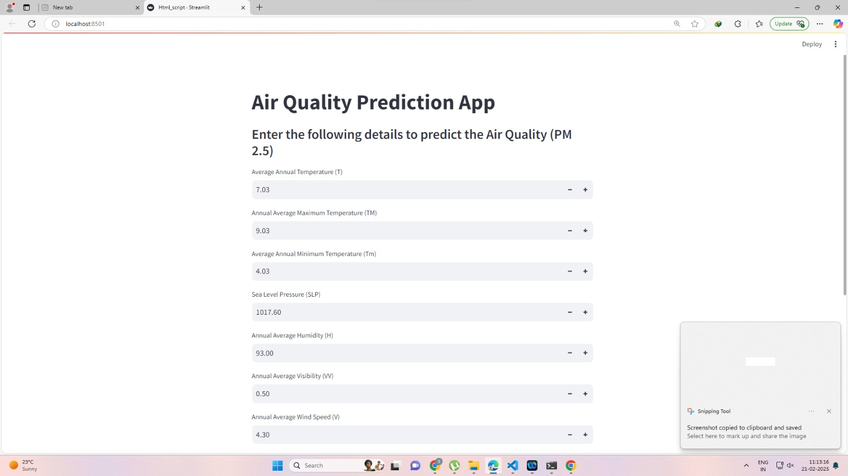
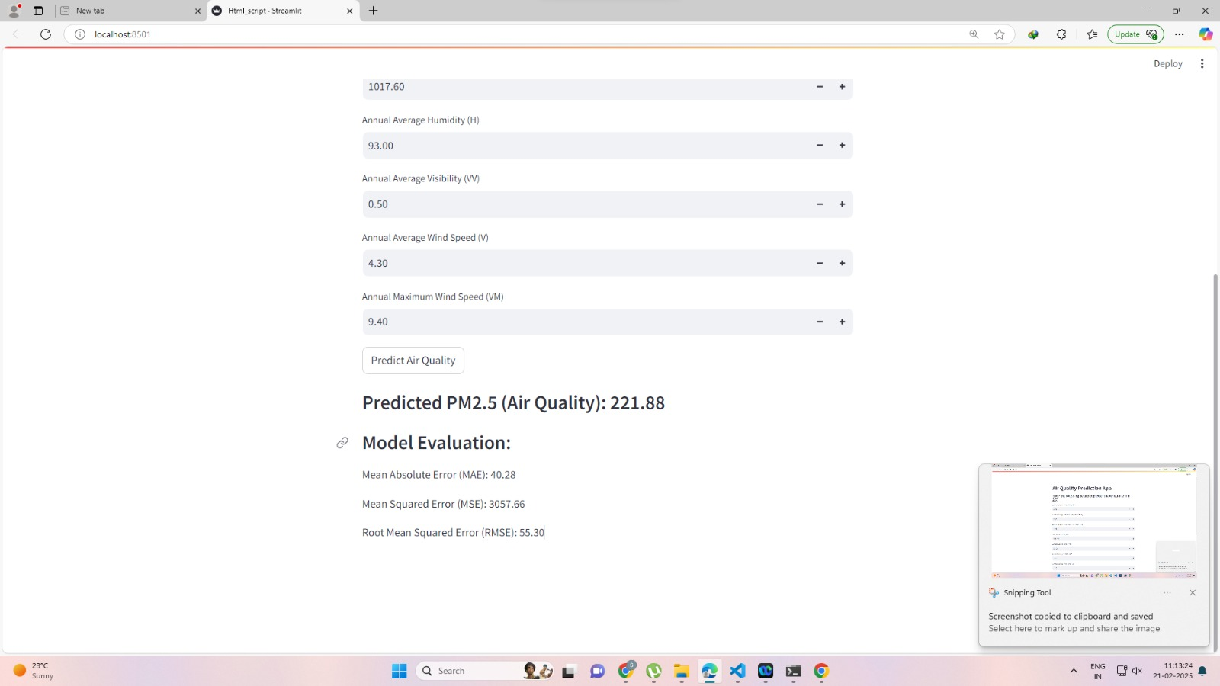
Results
Source :
www.freepik.com/

Slide 7

Conclusion
Data Preprocessing: The dataset, including air quality indicators, weather data, and location details, was cleaned and prepared by handling missing values and outliers to ensure accurate predictions.
Feature Selection: Relevant features like PM2.5, PM10, temperature, humidity, and wind speed were identified and analyzed to understand their impact on air quality.
Model Development: We tested various machine learning models and selected the one with the best accuracy to predict air quality levels.
Prediction Accuracy: The model accurately predicted air quality values (e.g., AQI levels), showing its potential for real-world use in air quality forecasting.
Real-World Applications: The model can be used for real-time air quality monitoring and help policymakers take necessary actions to control pollution.
Challenges: We faced issues like missing data, seasonal changes, and pollutant imbalances. Future work can focus on improving data quality and adding features like traffic data for better predictions.
Source :
www.freepik.com/

Slide 8
References
Datasets:
UCI Machine Learning Repository – Air Quality Dataset Contains air quality data (e.g., PM2.5, PM10, temperature, humidity) from a specific location. Link to Dataset
Kaggle Datasets Offers a variety of air quality prediction datasets with historical pollution data. Link to Kaggle Datasets
EPA Air Quality Data Provides U.S. air quality data for locations across the country. Link to EPA Air Quality Data
Research Papers:
"Air Quality Prediction Using Machine Learning Algorithms" Reviews machine learning techniques like decision trees and neural networks for air quality prediction. Link to Paper
"A Survey on Machine Learning Approaches in Air Quality Prediction" Compares various machine learning models used in air quality prediction. Link to Paper
"Predicting Air Quality with Machine Learning" Discusses using deep learning models and big data for predicting air quality. Link to Paper

Slide 9
Thank You
Notes:
Thank You !!

